Slide 1
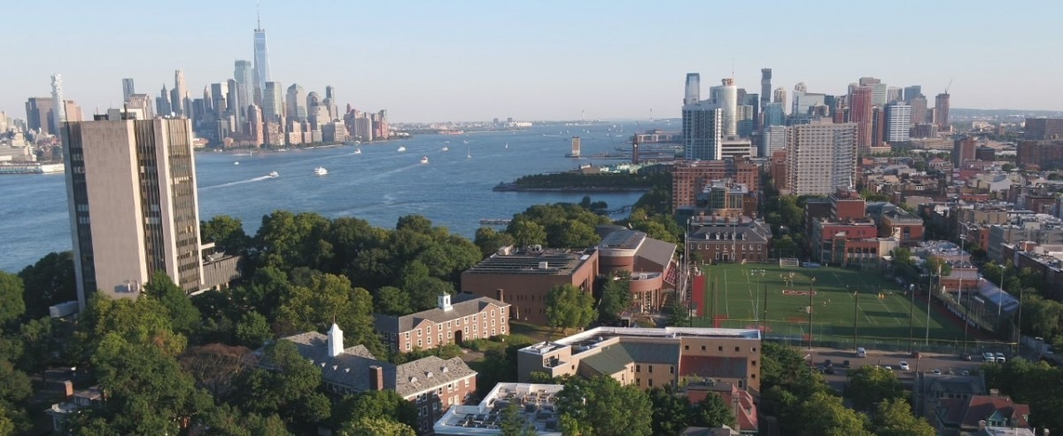
Week 4
An Introduction to Cyber Security – CS 573
Instructor: Dr. Edward G. Amoroso
eamoroso@tag-cyber.com

Slide 2
Week 4
Required Week Four Readings
1. “A Man-in-the-Middle Attack on UMTS,” U. Meyer and S. Wetzel
https://www.cs.stevens.edu/~swetzel/publications/mim.pdf
2. Chapters 12 through 16: From CIA to APT: An Introduction
to Cyber Security, E. Amoroso & M. Amoroso
Twitter: @hashtag_cyber
LinkedIn: Edward Amoroso

Slide 3
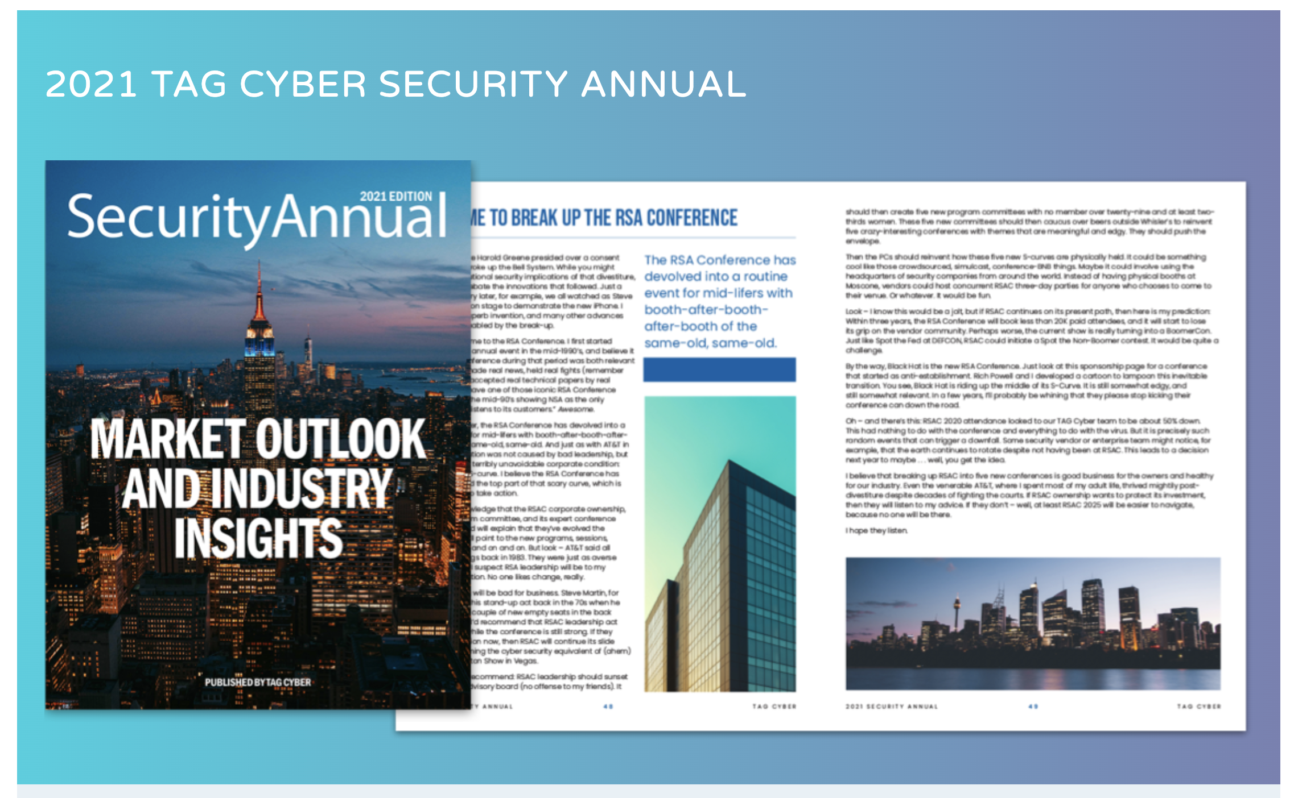
Week 4
Required Additional Reading: https://www.tag-cyber.com/advisory/annuals

Slide 4
Week 4: Threat-Vulnerability Analysis
Week 4

Slide 5
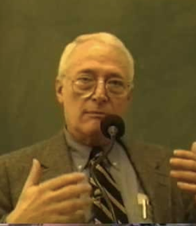
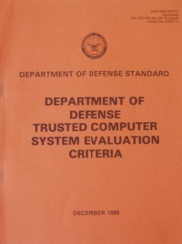
Cyber Security: Subject-Object Reference Model
Week 4
Reference Monitor
(Security)
James Anderson
Subject
Operation
(Read, Write)
Allow or
Disallow
Object
Malicious or
Benign
Altering versus
Non-Altering
Based on
Security Policy
Mission-Related
Priority
Orange Book

Slide 6
Cyber Security: Basic Operational Framework
Week 4
Security
System
Adversary
Asset
Access

Slide 7
Cyber Security: Adversary Types
Week 4
Security
System
Adversary
Asset
Access
Adversary Type
Motivation
Defining Attributes
Hacker
Mischief
Individually Capable, Predictable
Hacktivist
Anger
Group Capable, Unpredictable
Criminal
Greed
Well Funded, Financial Motivation
Nation-State
Dominance
World Class Capability and Support

Slide 8
Cyber Security: Vulnerability Types
Week 4
Security
System
Adversary
Asset
Access
Vulnerability
Vulnerability Type
Root Cause
Defining Attributes
System Flaw
Complexity
Insufficient design, test, build, operate
Lack of Security
Budget
Attention not paid to proper protection
Human Actions
Ignorance
Lack of security awareness and training
Organizational
Irresponsibility
Inadequate staff, procedures, and process

Slide 9
Cyber Security: Threat Types
Week 4
Security
System
Adversary
Asset
Access
Threat Type
Motivation
Defining Attributes
Disclosure
Secrets
Personal and Business Information
Integrity
Degradation
Remote Operational Control/Change
Denial of Service
Disruption
Distributed Botnet Attacks Common
Theft/Fraud
Money/Goods
Ingenious and Clever Means for Theft

Slide 10

Def: Assets – Resources required for organization to meet its mission.
Week 4

Slide 11
Def: Threats – Malicious outcomes levied against assets.
Week 4

Slide 12

Def: Confidentiality Threat – Information disclosed to unauthorized parties.
Week 4

Slide 13
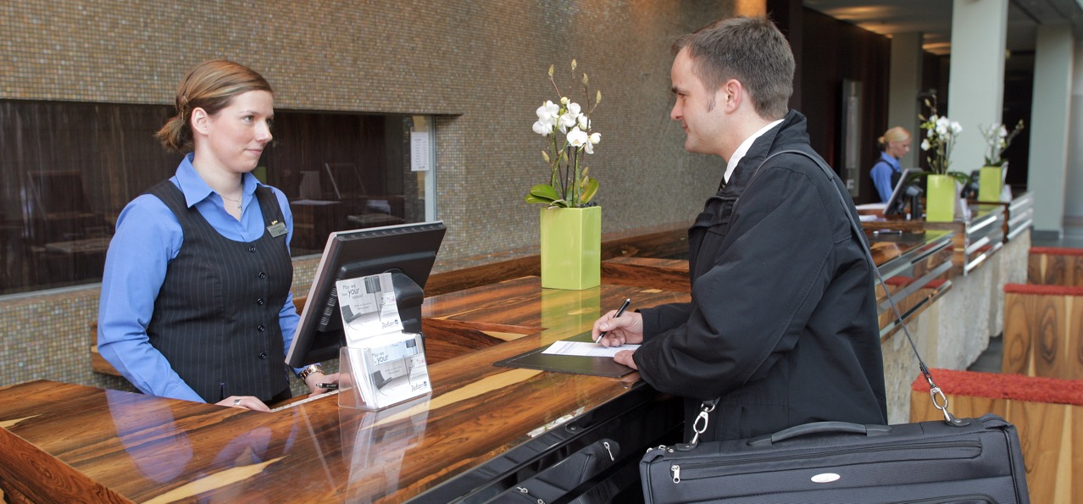
Def: Privacy Threat – Personal information disclosed to unauthorized parties.
Week 4

Slide 14

Def: Integrity Threat – Asset maliciously altered (includes destroyed).
Week 4

Slide 15
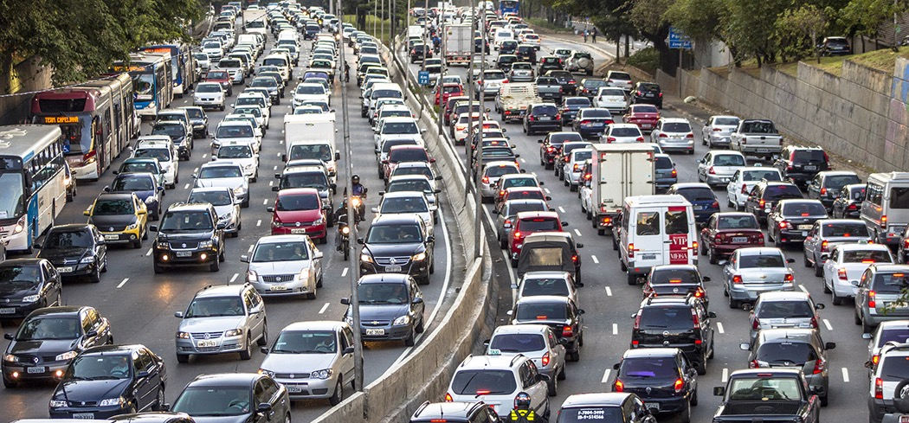
Def: Availability Threat – Asset maliciously blocked from authorized use.
Week 4

Slide 16

Def: Theft/Fraud – Stealing service or product without paying.
Week 4

Slide 17

Def: Vulnerability – System bug or attribute that can be maliciously exploited.
Week 4

Slide 18
Def: Attack – Sequence of steps to exploit a vulnerability.
Week 4
Brute Force – Try every possibility
Heuristic – Find useful shortcut method

Slide 19
Week 4
Risk (R) equals
Probability (P) of Threat
times
Consequence (C) of Threat
R = P * C
Def: Risk – Probability “Times” Consequence

Slide 20
Week 4
Irrational Choice
WORST CASE
Purchase and
Install Security
System
Increase
Spend
Decrease Security
Increase Security
Reduce
Spend
Remove Security
System and
Accept Risk
Innovation
BEST CASE
Security Risk Assessment – Decision Framework

Slide 21
Week 4
Illustrating Tiered Prioritization of Assets

Slide 22
Replaceability
Week 4
Convenience
Sensitivity
Emotion
Dependence
Liability
Stewardship
Finance
Illustrating Tiered Prioritization of Assets
Preference

Slide 23
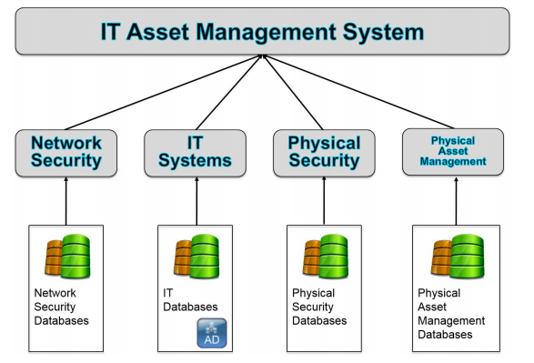
Week 4
NIST IT Asset Management System Model

Slide 24
Replaceability
Week 4
Convenience
Sensitivity
Emotion
Dependence
Liability
Stewardship
Finance
NIST IT Asset Management System Model
Preference

Slide 25
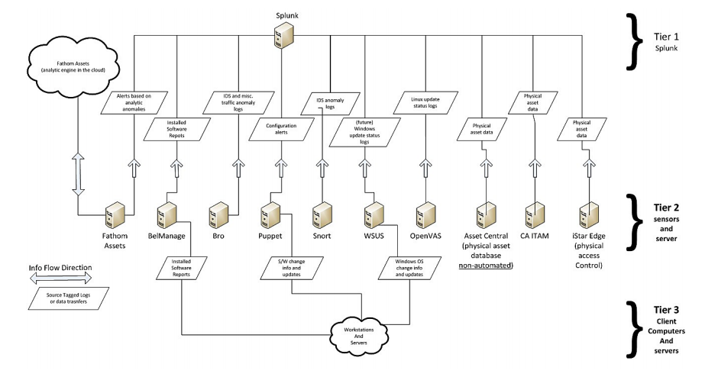
Week 4
NIST IT Asset Management (ITAM) Dataflow Reference Architecture

Slide 26
Premise
Network Device Connectivity Map
Week 4
Routers
Switches
Hosts
Vulnerability Data
Collect
Network Data
Process and
Analyze
Generate
Connection Model
. . .
Asset Discovery
Platform (Network Data)
Load Balancers
Cloud
Workloads
Applications
. . .
Typical Automated Asset Discovery
Google, Microsoft,
AWS, VMWare, Cisco

Slide 27
Week 4
Threat 1
Threat 2
. . .
List the threats
(Probably CIA)
Threat m
Asset 1
Asset 2
.
.
.
Asset n
List the assets
(Based on mission)
Developing a Threat-Asset Matrix

Slide 28
Week 4
Threat 1
Threat 2
. . .
Threat m
Asset 1
Asset 2
.
.
.
Create (m x n) Matrix
of Threat-Asset Pairs
Asset n
Developing a Threat-Asset Matrix

Slide 29
Week 4
Threat 1
Threat 2
. . .
Threat m
Asset 1
Asset 2
Estimate Risk
Associated
With Each Cell
.
.
.
Asset n
Developing a Threat-Asset Matrix

Slide 30
Week 4
Confidentiality
Integrity
Availability
P = 3, 2, 1
C = 3, 2, 1
R = P * C
Estimate probability P
and consequence C on
simple scale (3, 2, 1)
Hardware
Software
Information
Developing a Threat-Asset Matrix

Slide 31
Week 4
Confidentiality
Integrity
Availability
P = 3, 2, 1
C = 3, 2, 1
R = P * C
P = 3, 2, 1
C = 3, 2, 1
R = P * C
P = 3, 2, 1
C = 3, 2, 1
R = P * C
Hardware
Perform risk estimates
one-by-one for entire
threat-asset matrix
P = 3, 2, 1
C = 3, 2, 1
R = P * C
P = 3, 2, 1
C = 3, 2, 1
R = P * C
P = 3, 2, 1
C = 3, 2, 1
R = P * C
Software
P = 3, 2, 1
C = 3, 2, 1
R = P * C
P = 3, 2, 1
C = 3, 2, 1
R = P * C
P = 3, 2, 1
C = 3, 2, 1
R = P * C
Information
Developing a Threat-Asset Matrix

Slide 32
Week 4
Rackspace Website
(Marketing)
Box Cloud Storage
(Production Software Download)
Macs
Macs
ADP Payroll
(Employee Data and Payments)
WiFi
(To Public or
Broadband)
Internet-Based
Cloud-Hosted
Services
Office 365
(Email and Calendar)
iPhones
Mobile ISP
Wells Fargo Bank
(Checking and Savings Account)
Salesforce
(CRM and Customer Info)
Case Study: Manage and Secure Assets for ACME Software-R-Us Inc.

Slide 33
Week 4
Developer MACs (Software, etc.)
Developer iPhones (Email, Photos, etc.)
Rackspace Website (Papers, PDFs, etc.)
Box Cloud Storage (Production Software)
Eight major
asset types
ADP Payroll (Employee PII, etc.)
Office 365 (Email, Calendars, etc.)
Wells Fargo Bank (Checking Acct, etc.)
Salesforce (CRM, Customer Data, etc.)
Illustrating a Threat-Asset Matrix: ACME Software-R-US Inc.

Slide 34
Week 4
Confidentiality
Integrity
Availability
Theft/Fraud
Developer MACs (Software, etc.)
Developer iPhones (Email, Photos, etc.)
Rackspace Website (Papers, PDFs, etc.)
Four major
threat types
Box Cloud Storage (Production Software)
ADP Payroll (Employee PII, etc.)
Office 365 (Email, Calendars, etc.)
Wells Fargo Bank (Checking Acct, etc.)
Salesforce (CRM, Customer Data, etc.)
Illustrating a Threat-Asset Matrix: ACME Software-R-US Inc.

Slide 35
Week 4
Confidentiality
Integrity
Availability
Theft/Fraud
Developer MACs (Software, etc.)
Developer iPhones (Email, Photos, etc.)
Rackspace Website (Papers, PDFs, etc.)
Box Cloud Storage (Production Software)
ADP Payroll (Employee PII, etc.)
Office 365 (Email, Calendars, etc.)
Wells Fargo Bank (Checking Acct, etc.)
Salesforce (CRM, Customer Data, etc.)
Create an (8 X 4) matrix = 32 cells to analyze
Illustrating a Threat-Asset Matrix: ACME Software-R-US Inc.

Slide 36
Cell 1: Software (source code) in development on the Mac is valuable to a competitor, but Mac is
reasonably well protected against malware:
Estimate: P = 2, C = 3, R = 6
Week 4
Confidentiality
Integrity
Availability
Theft/Fraud
Developer MACs (Software, etc.)
6
Developer iPhones (Email, Photos, etc.)
Rackspace Website (Papers, PDFs, etc.)
Box Cloud Storage (Production Software)
ADP Payroll (Employee PII, etc.)
Office 365 (Email, Calendars, etc.)
Wells Fargo Bank (Checking Acct, etc.)
Salesforce (CRM, Customer Data, etc.)
Illustrating a Threat-Asset Matrix: ACME Software-R-US Inc.

Slide 37
Cell 2: Contacts and email are somewhat valuable to a competitor, but iPhone is biometrically well-protected against physical access:
Estimate: P = 1, C = 2, R = 2
Week 4
Confidentiality
Integrity
Availability
Theft/Fraud
Developer MACs (Software, etc.)
6
Developer iPhones (Email, Photos, etc.)
2
Rackspace Website (Papers, PDFs, etc.)
Box Cloud Storage (Production Software)
ADP Payroll (Employee PII, etc.)
Office 365 (Email, Calendars, etc.)
Wells Fargo Bank (Checking Acct, etc.)
Salesforce (CRM, Customer Data, etc.)
Illustrating a Threat-Asset Matrix: ACME Software-R-US Inc.

Slide 38
Cell 3: Website reasonably well-administered
but nothing all that sensitive is stored in the
marketing oriented site (no eCommerce).
Estimate: P = 1, C = 1, R = 1
Week 4
Confidentiality
Integrity
Availability
Theft/Fraud
Developer MACs (Software, etc.)
6
Developer iPhones (Email, Photos, etc.)
2
Rackspace Website (Papers, PDFs, etc.)
1
Box Cloud Storage (Production Software)
ADP Payroll (Employee PII, etc.)
Office 365 (Email, Calendars, etc.)
Wells Fargo Bank (Checking Acct, etc.)
Salesforce (CRM, Customer Data, etc.)
Illustrating a Threat-Asset Matrix: ACME Software-R-US Inc.

Slide 39
Cell 4: This represents public cloud storage and customer download support for the company’s production software, thus high risk estimated.
Estimate: P = 3, C = 3, R = 9
Week 4
Confidentiality
Integrity
Availability
Theft/Fraud
Developer MACs (Software, etc.)
6
Developer iPhones (Email, Photos, etc.)
2
Rackspace Website (Papers, PDFs, etc.)
1
Box Cloud Storage (Production Software)
9
ADP Payroll (Employee PII, etc.)
Office 365 (Email, Calendars, etc.)
Wells Fargo Bank (Checking Acct, etc.)
Salesforce (CRM, Customer Data, etc.)
Illustrating a Threat-Asset Matrix: ACME Software-R-US Inc.

Slide 40
Cells 5 - 8: These are well-managed SaaS services with sensitive data stored and accessible to
hackers. Estimated suitable risk profiles for each.
Week 4
Confidentiality
Integrity
Availability
Theft/Fraud
Developer MACs (Software, etc.)
6
Developer iPhones (Email, Photos, etc.)
2
Rackspace Website (Papers, PDFs, etc.)
1
Box Cloud Storage (Production Software)
9
ADP Payroll (Employee PII, etc.)
P = 1, C = 2, R = 2
Office 365 (Email, Calendars, etc.)
P = 2, C = 3, R = 6
Wells Fargo Bank (Checking Acct, etc.)
P = 1, C = 2, R = 2
Salesforce (CRM, Customer Data, etc.)
P = 2, C = 3, R = 6
Illustrating a Threat-Asset Matrix: ACME Software-R-US Inc.

Slide 41
Week 4
Confidentiality
Integrity
Availability
Theft/Fraud
Developer MACs (Software, etc.)
6
Developer iPhones (Email, Photos, etc.)
2
Rackspace Website (Papers, PDFs, etc.)
1
Box Cloud Storage (Production Software)
9
ADP Payroll (Employee PII, etc.)
2
Office 365 (Email, Calendars, etc.)
6
Wells Fargo Bank (Checking Acct, etc.)
2
Salesforce (CRM, Customer Data, etc.)
6
Illustrating a Threat-Asset Matrix: ACME Software-R-US Inc.

Slide 42
Week 4
Confidentiality
Integrity
Availability
Theft/Fraud
Developer MACs (Software, etc.)
6
6
2
2
Developer iPhones (Email, Photos, etc.)
2
2
2
2
Rackspace Website (Papers, PDFs, etc.)
1
6
3
1
Box Cloud Storage (Production Software)
9
9
9
9
ADP Payroll (Employee PII, etc.)
2
2
2
2
Office 365 (Email, Calendars, etc.)
6
6
3
1
Wells Fargo Bank (Checking Acct, etc.)
2
2
1
3
Salesforce (CRM, Customer Data, etc.)
6
6
1
4
Illustrating a Threat-Asset Matrix: ACME Software-R-US Inc.

Slide 43
Week 4
Business Asset
Estimated Risk
Box Cloud Storage (Production Software)
Total Risk = 36 – 1st Highest Risk Asset
Salesforce (CRM, Customer Data, etc.)
Total Risk = 17 – 2nd Highest Risk Asset
Developer MACs (Software, etc.)
Total Risk = 16 – 3rd Highest Risk Asset
Office 365 (Email, Calendars, etc.)
Total Risk = 16 – 3rd Highest Risk Asset
Rackspace Website (Papers, PDFs, etc.)
Total Risk = 11 – 4th Highest Risk Asset
Developer iPhones (Email, Photos, etc.)
Total Risk = 08 – Lowest Risk Asset
ADP Payroll (Employee PII, etc.)
Total Risk = 08 – Lowest Risk Asset
Wells Fargo Bank (Checking Acct, etc.)
Total Risk = 08 – Lowest Risk Asset
Illustrating a Threat-Asset Matrix: ACME Software-R-US Inc.

